Slide 1

PID LINE FOLLOWING CAR
Ozan Emre Tunca

Slide 2
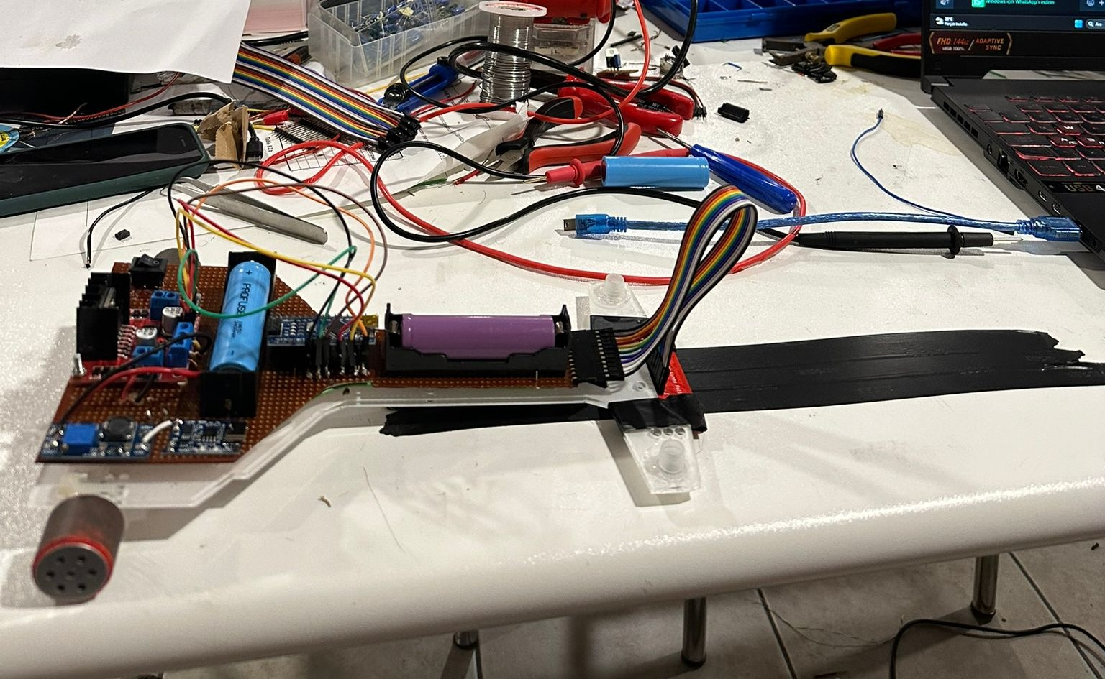
INTRODUCTION
In this project, a line-following robot was designed and implemented using the PID (Proportional-Integral-Derivative) control algorithm. Line-following robots are autonomous vehicles capable of following a path drawn on a specific track and are widely used in industrial applications. In our project, we utilized components such as the Pololu QTR-8A line sensor, Arduino Nano microcontroller, L298N motor driver, and N20 micro DC motors.

Slide 3
OBJECTIVES AND GOALS
01
Design of the Robot
03
Steady Perfomance
02
Line Following
04
Cost - Efficiency

Slide 4
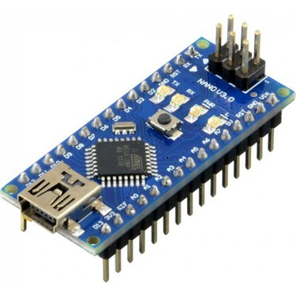
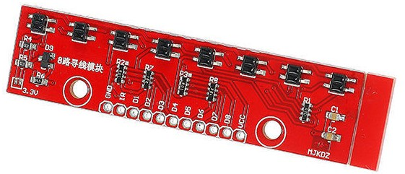
Arduino Nano
The line data received through the sensors was processed by the PID control algorithm running on Arduino Nano and transferred to the motor driver. In this way, the robot was able to follow the line accurately and react.
QTR-8A IR SENSOR
Designed for line-following robots, this sensor board features 8 IR LED/phototransistor pairs spaced 1cm apart. A pull-up resistor is connected to each sensor. The voltage output changes analogously depending on whether the ground reflects light or its distance from the object. As the reflection increases, the output voltage also increases.

Slide 5
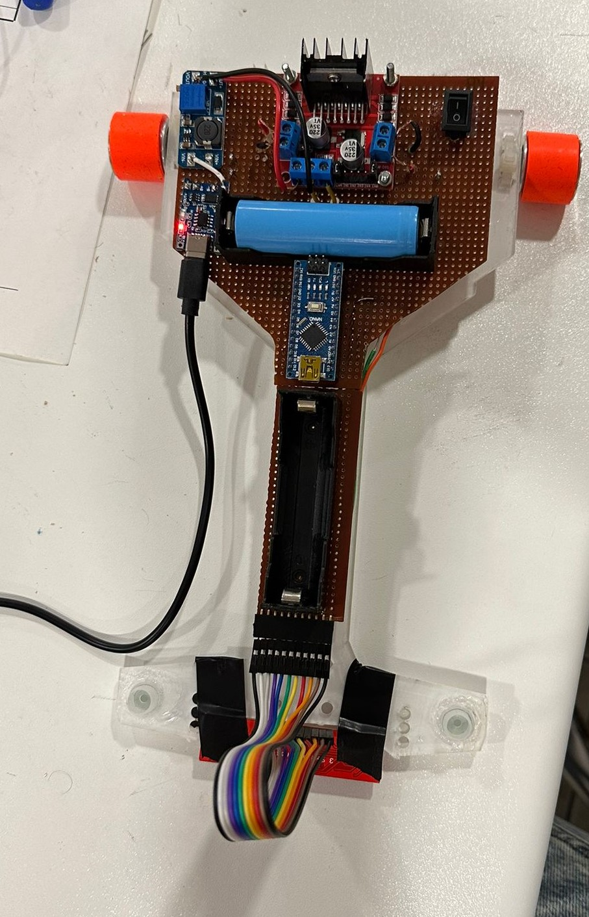
01
OUR ELECTRICAL SYSTEM
Firstly, we connected the L298N motor driver to the N20 micro DC motors. The L298N motor driver is a robust motor control device and is an ideal choice for DC motors. N20 micro DC motors are known for their compact size and high efficiency, and they are used in various applications.
Next, we connected two 3.7V 2400mAh batteries in parallel. This battery configuration provides high-capacity power, allowing for extended operation. Parallel connection maintains the voltage while increasing the total capacity.
With this connection, both the QTR-8A line sensor and the Arduino Nano microcontroller, as well as the motor drivers, are powered.

Slide 6
CODES
02
#define Kp 0.4
#define Ki 0.01
#define Kd 2
#define rightMotor1 11
#define rightMotor2 12
#define rightMotorPWM 9
#define leftMotor1 5
#define leftMotor2 6
#define leftMotorPWM 3
  Kp (Proportional): Adjusts motor speed based on the magnitude of the error.
  Ki (Integral): Uses the sum of past errors to adjust motor speed.
  Kd (Derivative): Adjusts motor speed based on the rate of change of the error.These parameters determine how quickly and steadily the robot will follow the line.
  Motor Pins: Pins used to control the direction and speed of the motors.
  PWM Pins: Used to control motor speeds with analog signals.

Slide 7
CODES
03
void loop() {
unsigned int position = qtr.readLineBlack(sensorValues);
int error = position - 3500;
integral += error;
int motorSpeed = Kp * error + Ki * integral + Kd * (error - lastError);
lastError = error;
int rightMotorSpeed = rightBaseSpeed + motorSpeed;
int leftMotorSpeed = leftBaseSpeed - motorSpeed;
if (rightMotorSpeed > rightMaxSpeed) rightMotorSpeed = rightMaxSpeed;
if (leftMotorSpeed > leftMaxSpeed) leftMotorSpeed = leftMaxSpeed;
if (rightMotorSpeed < 0) rightMotorSpeed = 0;
if (leftMotorSpeed < 0) leftMotorSpeed = 0;
digitalWrite(rightMotor1, HIGH);
digitalWrite(rightMotor2, LOW);
analogWrite(rightMotorPWM, rightMotorSpeed);
digitalWrite(leftMotor1, HIGH);
digitalWrite(leftMotor2, LOW);
analogWrite(leftMotorPWM, leftMotorSpeed);
}
Reading Line Position: The position of the line is read from the sensors.
Calculating Error: Calculates how far the line is from the center.
PID Control: Uses error values to adjust motor speeds.
Setting Motor Speeds: Motor speeds are calculated and limited.
Controlling Motors: Motors are controlled based on the calculated speeds.

Slide 8
COST ANALYST
Product | Number | Cost (Turkish Liras)
Line-following car body | 1 | 49,76
Mini drunk wheel | 2 | 2,82
L298N Voltage-Regulated Dual Motor Driver Board | 1 | 55
Silicon Wheel | 2 | 229,15
3.7 Volt 2400 mAh Li-on Battery | 2 | 220,20
Battery Bed | 2 | 20,30
Type-C Charging Module | 2 | 25
QTR-8A IR Sensor | 1 | 196,76
6V 600 rpm DC motor N20 | 2 | 175
2A Boost Converter Module | 1 | 20,85
Button | 1 | 15
TOTAL = 1009,84 Tl

Slide 9
FUTURE DEVELOPMENTS
Advanced Sensor Integration:
Additional Sensors: Incorporate additional sensors such as ultrasonic or LiDAR for obstacle detection and avoidance.
Sensor Fusion: Implement sensor fusion techniques to improve line detection accuracy and robustness.
Algorithm Enhancement:
Adaptive PID Control: Develop adaptive PID algorithms that can adjust parameters in real-time based on changing conditions.
Machine Learning: Explore the use of machine learning techniques to enhance the car’s learning and decision-making capabilities.
Enhanced User Experience:
Mobile App Integration: Create a mobile application for remote control, monitoring, and configuration of the car.
User-Friendly Interface: Improve the calibration and setup process with a more intuitive interface.
Scalability and Applications:
Multiple Cars Coordination: Develop algorithms for coordinating multiple cars for tasks such as cooperative transportation or racing.
Real-World Applications: Adapt the technology for real-world applications like automated delivery systems or industrial automation.

Slide 10
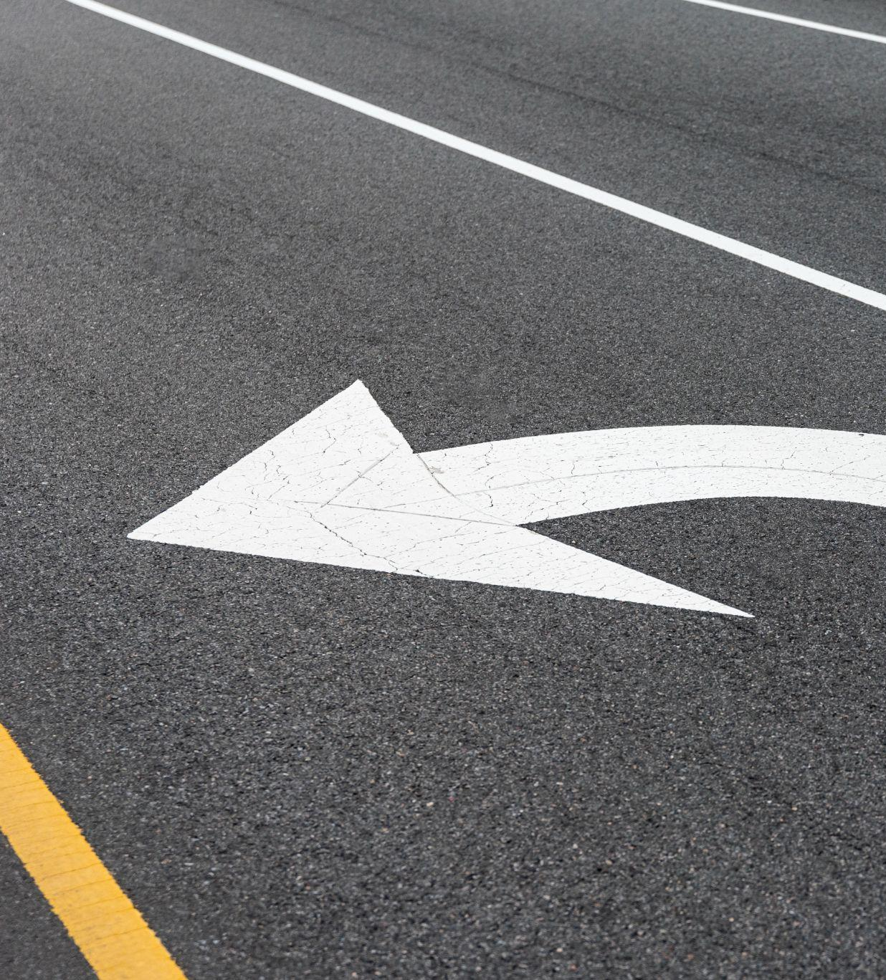
REFENRENCES
Robotistan
Google Images
https://app.arduino.cc/sketches/8f43a49f-aab5-494d-8dcf-c9f00e55a3c1?view-mode=preview
Pololu QTR-8A Reflectance Sensor Array Datasheet
•Pololu. (n.d.). QTR-8A Reflectance Sensor Array. Retrieved from Pololu Product Page

